Slide 1

AI ENABLED INTEGRATED APPLICATION FOR LUGGAGE CAREER SYSTEM
AJAY KUMAR GARG ENGINEERING COLLEGE, GHAZIABAD
Project Presentation on
Guided By
Ms. Akansha Shukla
Presented By,
Atish Gorka (2000270110026)
Gaurav Singh (2000270110040)
Kartikey Tyagi (2100270119005)
Sahastranshu Mishra (2000270310134)

Slide 2

ABSTRACT
The importance of a luggage carrier system in today's era lies in its ability to address the challenges posed by increased travel, globalization, security concerns, and technological advancements. By providing efficient, secure, and data-driven solutions, these systems play a crucial role in shaping the future of the transportation and logistics industry. This project implements, the AI-enabled luggage carrier management system represents a paradigm shift in the transportation industry. By combining real-time tracking, route optimization, resource allocation, security features, GPS services, and advanced analytics, the system not only addresses current challenges but also sets the stage for a more efficient, secure, and data-driven future in luggage management.
The system incorporates a comprehensive set of features, including real-time luggage tracking, route optimization, resource allocation, security enhancements, and user authentication. Leveraging cutting-edge technologies such as GPS services, data analytics, and predictive modeling, the system aims to revolutionize the luggage management landscape. The real-time luggage tracking feature ensures that both carriers and users can monitor the exact location and status of luggage throughout its journey. Route optimization and resource allocation algorithms work in tandem to streamline carrier operations, minimizing travel time and maximizing resource utilization. Security features embedded within the system add an extra layer of protection, safeguarding luggage from potential threats or unauthorized access.

Slide 3
INTRODUCTION
The AI-enabled integrated application for a luggage carrier system represents a cutting-edge solution poised to revolutionize the efficiency, security, and overall experience within the logistics and transportation industry. By seamlessly merging artificial intelligence with sophisticated logistics management, this innovative application promises to optimize every facet of the luggage transit process. F
From automated route optimization based on real-time data to predictive maintenance leveraging advanced algorithms, the system ensures a streamlined and reliable service. Incorporating technologies such as GPS, RFID, and encryption based security, the application not only tracks the real-time location of luggage but also prioritizes security through advanced authentication measures.With features like image recognition for sorting, environmental impact analysis, and comprehensive data analytics for business intelligence, this AI-enabled application represents a holistic approach to modernize and enhance the luggage carrier ecosystem.

Slide 4
PROBLEM STATEMENT
The current luggage carrier system faces several challenges that impede operational efficiency and customer satisfaction. These challenges include suboptimal route planning, unreliable maintenance practices leading to unexpected downtimes, lack of real-time tracking causing inconvenience for travelers, and manual sorting processes that are prone to errors. Security concerns and the need for improved customer service also persist.
Additionally, the absence of integrated AI solutions results in missed opportunities for data-driven decision-making and proactive system management. In light of these challenges, there is a critical need for an AI-enabled integrated application for the luggage carrier system.
This solution aims to address inefficiencies, enhance security measures, and elevate the overall customer experience by leveraging artificial intelligence for optimized route planning, predictive maintenance, real-time tracking, automated sorting, and intelligent customer interactions. The objective is to create a seamlessly connected and technologically advanced luggage carrier system that not only meets industry standards but sets new benchmarks for reliability, efficiency, and passenger satisfaction.

Slide 5
OBJECTIVE AND SCOPE
The objective of the system that is aim to transform the luggage carrier system into a technologically advanced, secure, and customer-centric service that sets new standards for efficiency, reliability, and user satisfaction.
The scope of this project is extensive, with potential applications in various platforms, including transportation, goods delivery services, logistic services and even small scale industries to manage and maintain their luggage with ease.

Slide 6
TECHNICAL REQUIREMENTS
HARDWARE REQUIREMENTS
Intel(R) Core(TM) i5-7300U CPU @ 2.60GHz 2.71 GHz
4GB RAM
15MB Hard drive storage
SOFTWARE REQUIREMENTS
Anaconda Distribution
GPS
Vscode
Xampp Server

Slide 7
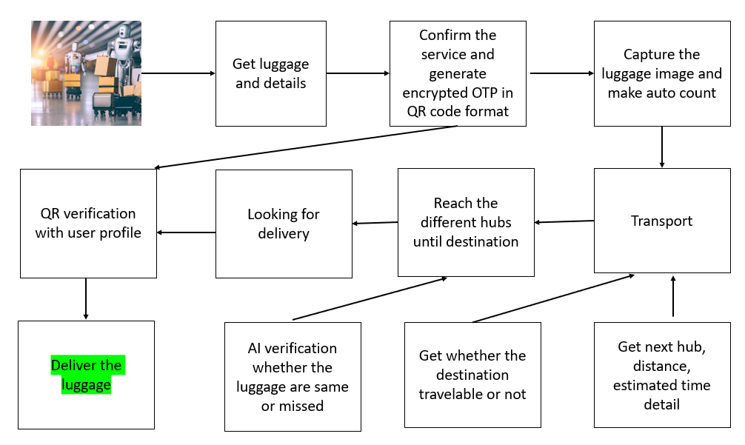
System overall architecture

Slide 8
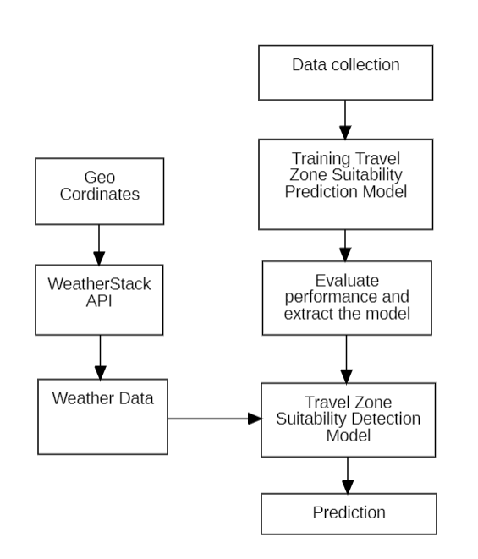
Destination suitability

Slide 9
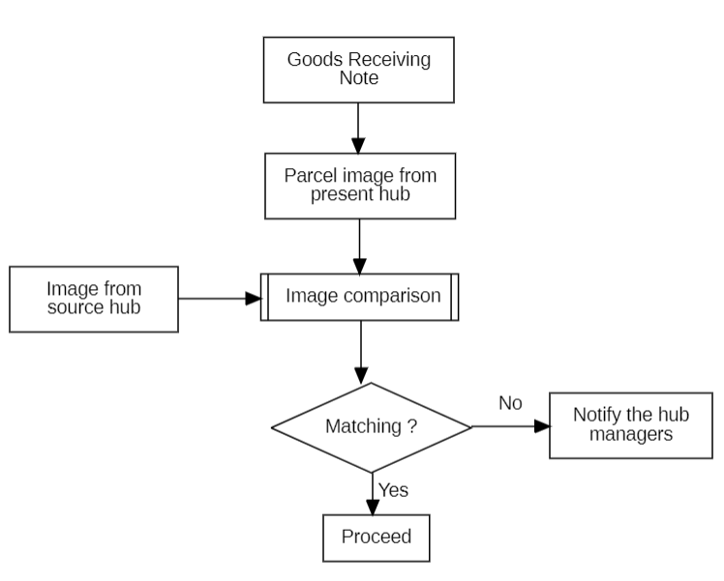
Parcel verification

Slide 10
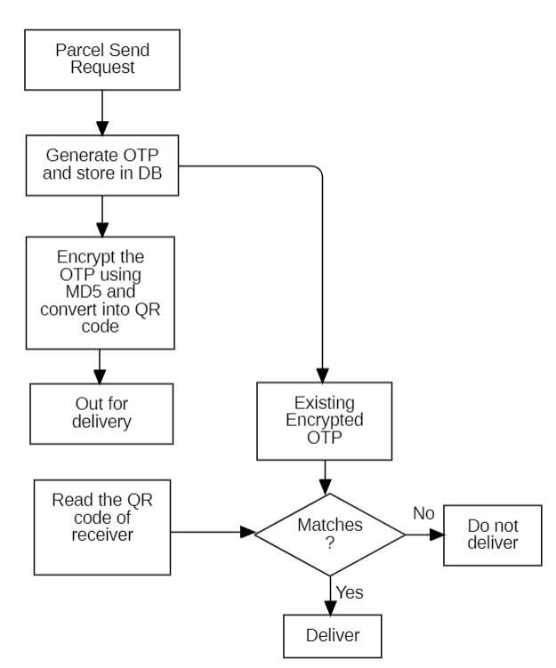
OTP ENCRYPTED QR DELIVERY

Slide 11
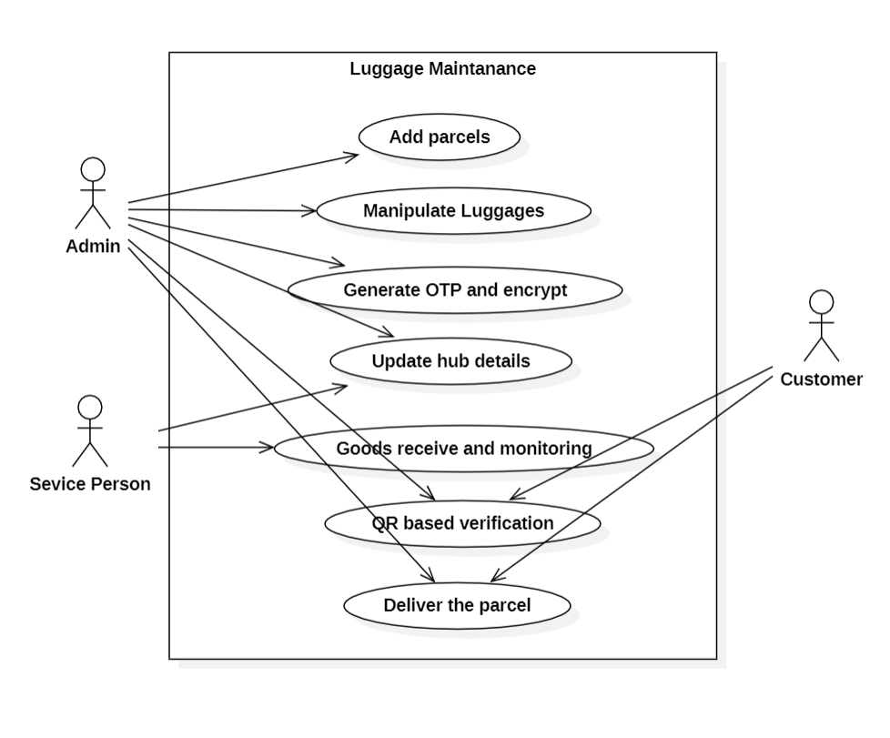
USE CASE DIAGRAM

Slide 12
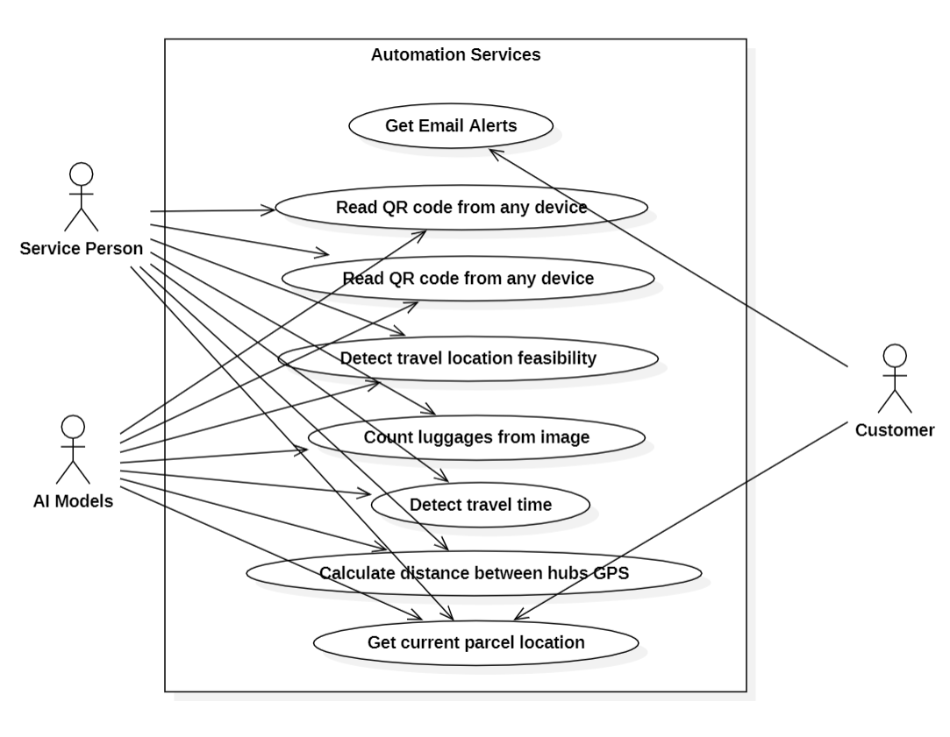
USE CASE DIAGRAM

Slide 13
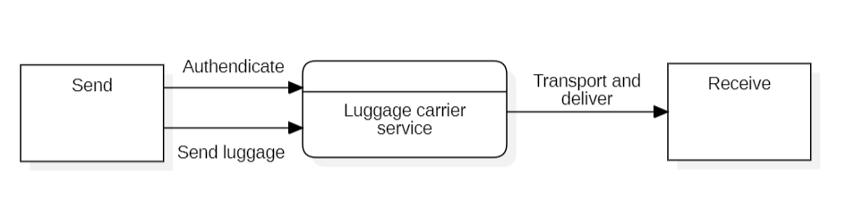
DATA FLOW DIAGRAM
LEVEL 0 DFD

Slide 14
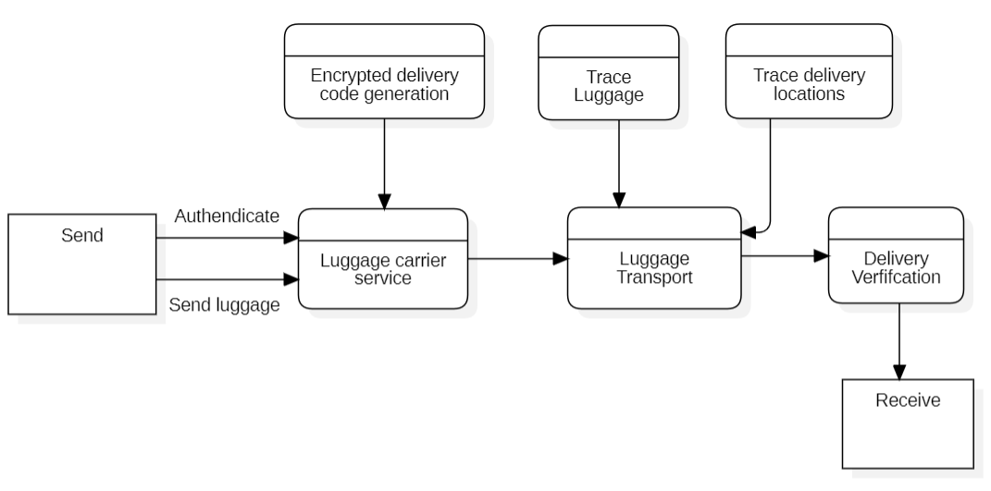
DATA FLOW DIAGRAM
LEVEL 1 DFD

Slide 15
METHODOLGIES USED
Data collection and Preprocessing
Pandas
NumPy and Matplotlib
2. Time, Route Estimation
Scikit Learn
3. Zone Comfortable Detection
GPS
Scikit – learn
4. Web GUI
HTML, CSS
Bootstrap
jQuery
5. Data Management
MySQL Database
6. Object Detection
Open cv
7. Encryption
Md5 and QR code

Slide 16
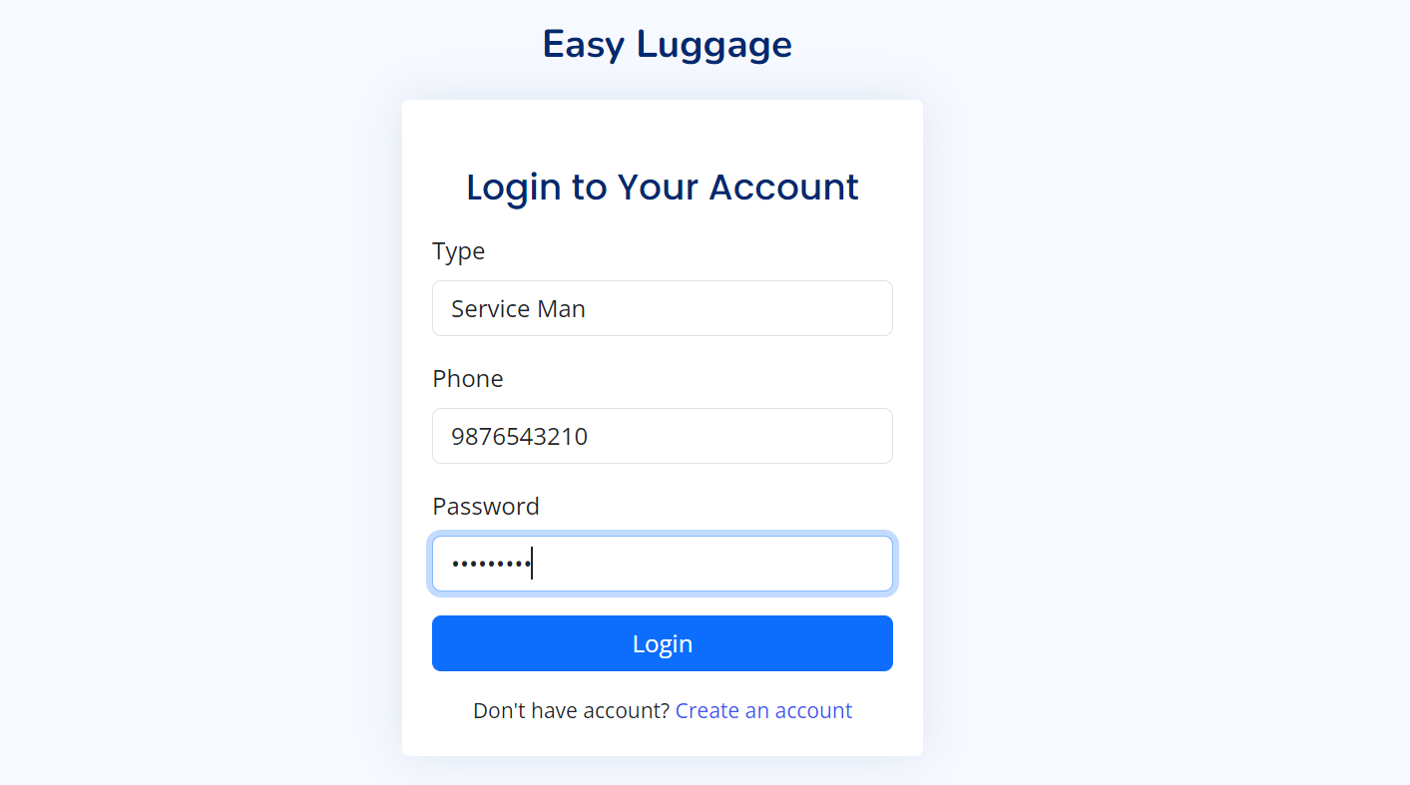
PROJECT GUI
PROFILE CREATION AND AUTHENDICATION

Slide 17

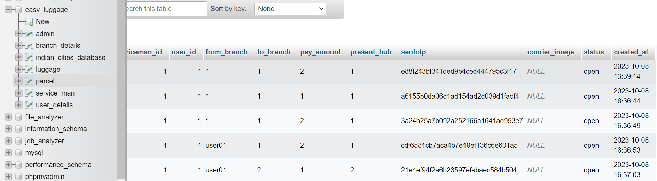
PROJECT GUI
LUGGAGE DATA WITH ENCRYPTED OTP AND GENERATED QR CODE

Slide 18
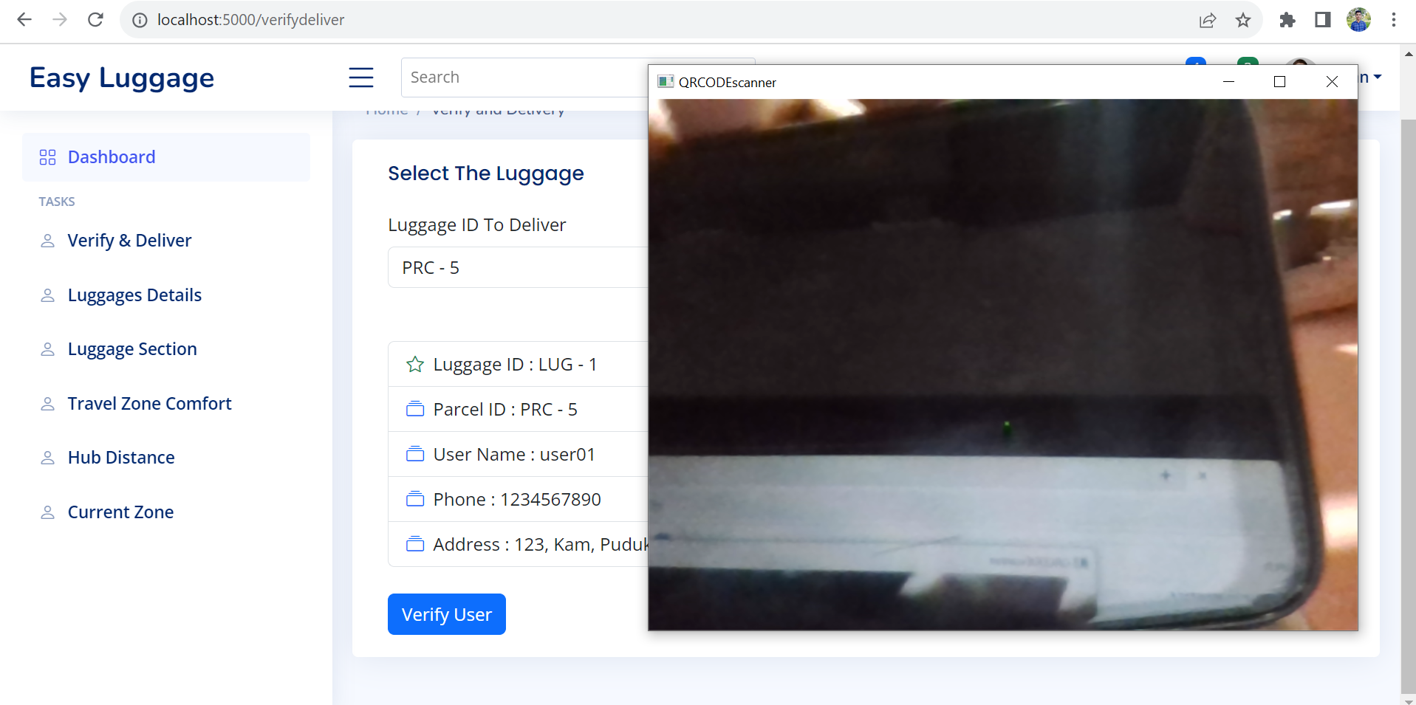
PROJECT GUI
RECEIVER QR CODE VERIFICATION

Slide 19
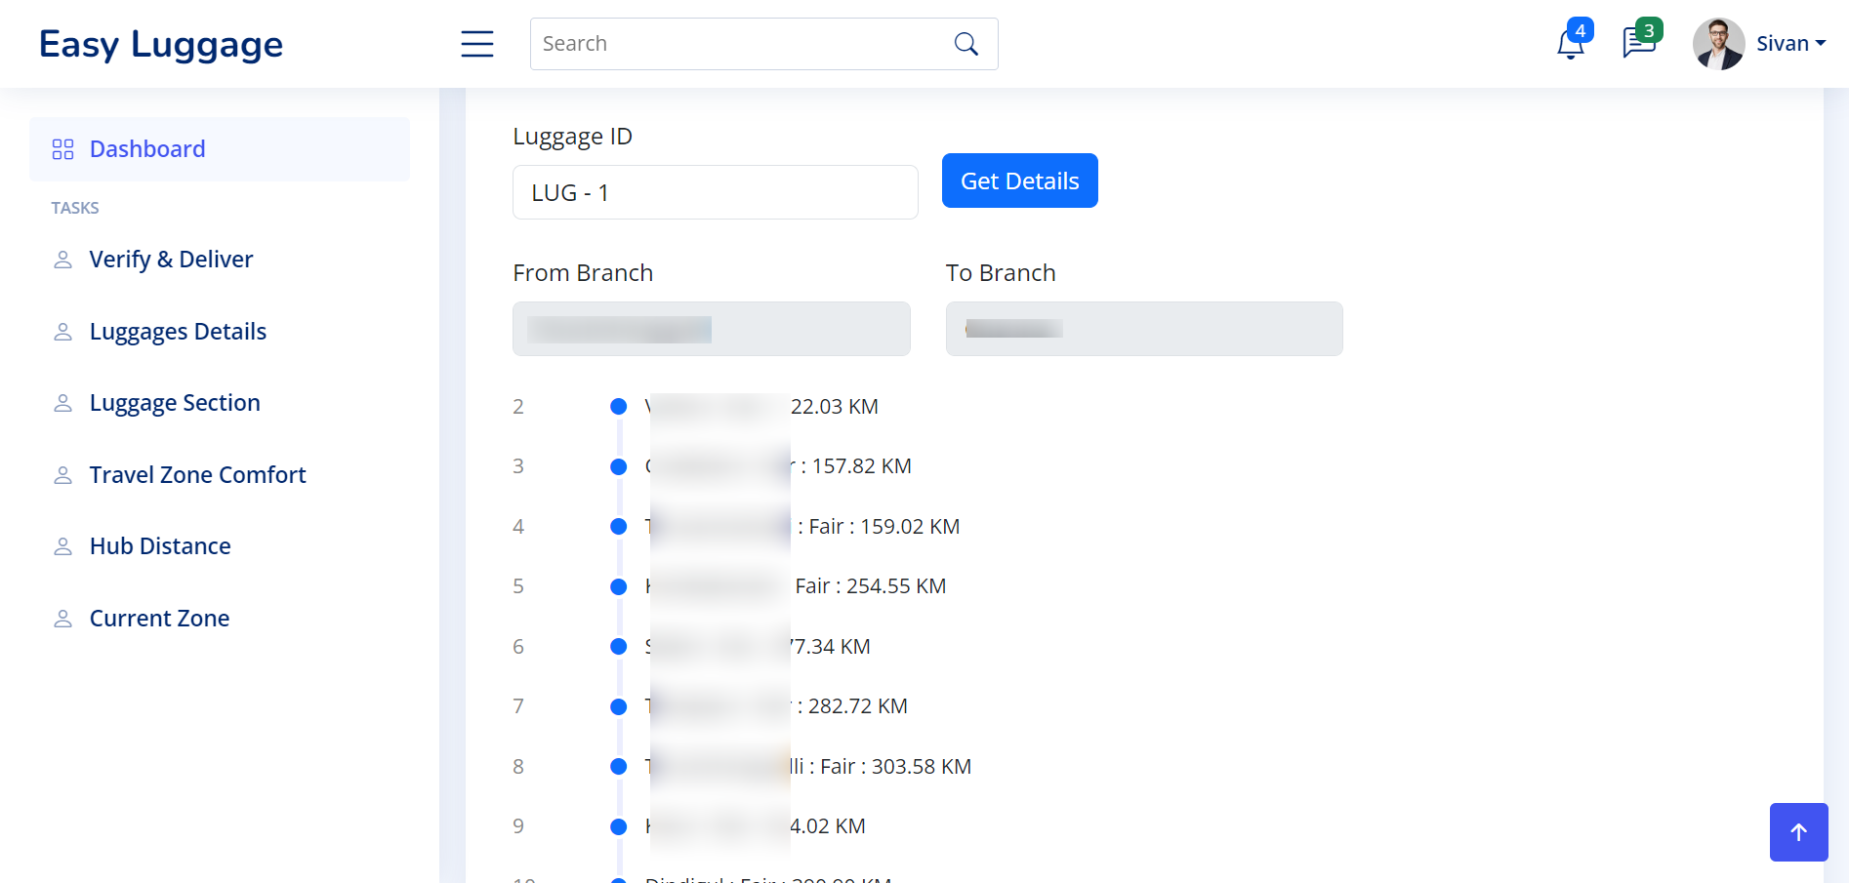
PROJECT GUI
NEXT HUB FAIR ESTIMATION USING GPS DATA

Slide 20
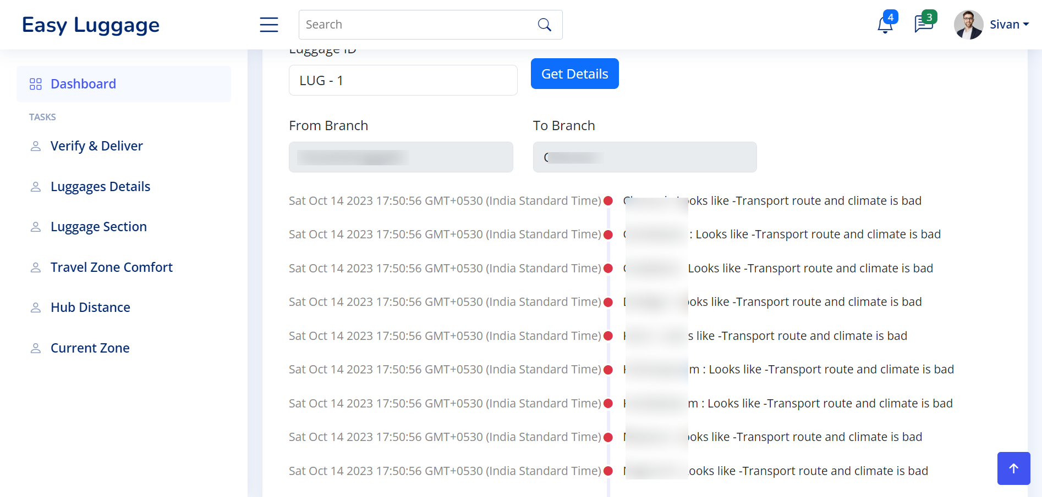
PROJECT GUI
TRANSPORT ROUTE COMPORT DETECTION

Slide 21
Project progress
As of now we started to develop the GUI and implemented some of the things like
Adding luggage
Count parcel from image
Encryption code generation
QR based verification
Hub distance measuring
Travel zone comfort detection
In upcoming reviews we will implement the rest of the functionalities and improve the accessibility of GUI and user based luggage tracing methods

Slide 22
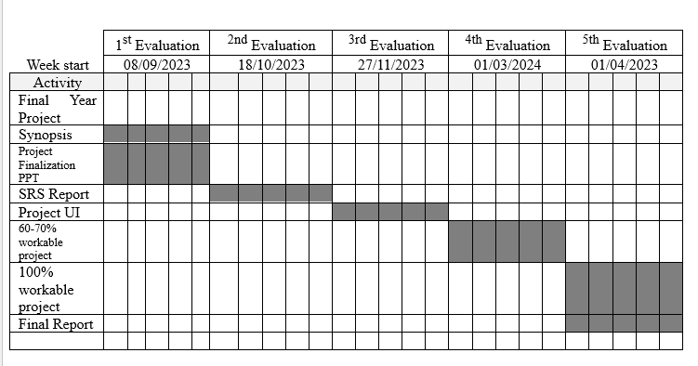
Gantt chart

Slide 23
REFERENCES
[1] Kalliopi Tsolaki, Thanasis Vafeiadis, Alexandros Nizamis, Dimosthenis Ioannidis and Dimitrios Tzovaras, Utilizing machine learning on freight transportation and logistics applications: A review, ICT Express 9, Elsevier, Volume 9, Issue 3, June 2023, https://doi.org/10.1016/j.icte.2022.02.001
[2] Terence, E. and Reddy, Siva and Reddy, K. Madhu and Reddy, T. Veera, Smart Luggage Carrier System, Proceedings of the International Conference on Innovative Computing & Communication (ICICC), May 27, 2022. Available at SSRN: https://ssrn.com/abstract=4121060 or http://dx.doi.org/10.2139/ssrn.4121060
[3] Tetsuya Manabe, Kazuo Mizuno, Keisuke Hatano and Masahiko Kaneko, "Ultraviolet sterilization information provision system of baggage carts and arriving baggage for airports", IATSS Research, December 2022. DOI:10.1016/j.iatssr.2022.12.004
[4] P. L. S. Krishnan, R. Valli, R. Priya and V. Pravinkumar, Smart Luggage Carrier system with Theft Prevention and Real Time TrackingUsing Nano Arduino structure, 2020 International Conference on System, Computation, Automation and Networking (ICSCAN), Pondicherry, India, 2020, pp. 1-5, doi: 10.1109/ICSCAN49426.2020.9262445.

Slide 24
REFERENCES
[5] Afrin Khan, Bandini Nalwade, Neha Kharshinge3, Sonali Kamble, SMART LUGGAGE SYSTEM, International Research Journal of Engineering and Technology (IRJET), Volume: 06 Issue: 11, Nov 2019, https://www.irjet.net/archives/V6/i11/IRJET-V6I1130.pdf.
[6] Senthil, Sudha & Krishnamurthy, Brindha & R, Charanya. LUGGAGE TRACKING SYSTEM USING IOT. International Journal of Pure and Applied Mathematics. 117. 49-54. September 2017. https://www.researchgate.net/publication/335978445_LUGGAGE_TRACKING_SYSTEM_USING_IOT
[7] Deepti Mishra and Alok Mishra, "Improving Baggage Tracking, Security and Customer Services with RFID in the Airline Industry", Improving Baggage Tracking, Security and Customer Services with RFID in the Airline Industry, Vol. 7, No. 2, 2010.
[8] DeVries, Peter. The state of RFID for effective baggage tracking in the airline industry. IJMC. Volume6. 151-164. January 2008. 10.1504/IJMC.2008.016574.

